Slide 1




Prompt Engineering & Agent Architectures
AI Season Bootcamp – Session 2
Master the art of communicating with AI, designing intelligent autonomous loops, and building programs faster using natural language workflows.
Owais Rafiq
Instructor
AISEASON
AI SEASON • DAY 2

Slide 2

Session Agenda
01 / Prompt Engineering Core
02 / Advanced Prompts & Agents
Anatomy of prompts and context engineering principles.
The Golden Formula: Roles, Tasks, Constraints & Outputs.
Few-shot pattern matching and Chain of Thought loops.
Designing operational Agent systems, loops & Vibe Coding.
AI SEASON • AGENDA
AISEASON

Slide 3

WHAT IS Prompt Engineering?
System Engineering Action
The deliberate, methodical practice of structuring language parameters to guide LLMs toward executing highly predictable, deterministic task responses without structural mutations.
"Prompt quality determines context quality, context quality drives reasoning capabilities, and reasoning determines final output success"
Logical Flow Loop
AI does not read human intent. It models token probability vectors. Prompt Engineering optimizes those context vectors to systematically reduce system entropy and logic drift.
AI SEASON • PROMPTING
AISEASON

Slide 4
Anatomy of a Good Prompt
Core Component | System Purpose | Implementation Action
Role Assignment | Initial Vector Anchor | Assign specialized personas (e.g., "Senior QA Architect").
Clear Task Instruction | Execution Target | Define explicit verbs and metrics describing the desired action.
Deep Context Data | Scope Limitation | Supply explicit codebase targets, API declarations, and inputs.
Explicit Constraints | Safety Boundaries | Declare explicit rules (e.g., "Exclude outdated frameworks").
Output Layout Rules | Downstream Parsing | Enforce predictable structures such as strict JSON models or tables.
AI SEASON • HOW TO WRITE GOOD PROMPTS
AISEASON

Slide 5



The Bad vs. Good Paradigm
The Weak baseline
Optimized System Prompt
"Write a responsive e-commerce web application page.“
Generates generic layout patterns, contains redundant boilerplate comments, uses random CSS architectures, and lacks cohesive UI patterns.
"Act as a React UI engineer. Write a responsive e-commerce landing page using Tailwind CSS. Output only clean, modular code components.“
Creates immediate, usable UI, utilizes production-ready Tailwind grids, excludes conversational filler, and operates directly in context.
AI SEASON • PROMPTING MATTERS
AISEASON

Slide 6
Core Prompting Techniques
Technique | Target Use Case | Operational Paradigm
Zero-Shot | Unseen, basic queries | Direct tasks instructions with zero context templates.
Few-Shot | Structured output alignment | Provide sample pairs of input-output models.
Chain of Thought | Deep math & architecture logic | Require step-by-step trace generation before response.
Role Prompting | Targeted domain expertise | Precondition system behaviors to expert frames.
System Instructions | Long-term guardrail control | Inject immutable boundaries and interface logic.
AI SEASON • PROMPTING TECHS
AISEASON

Slide 7
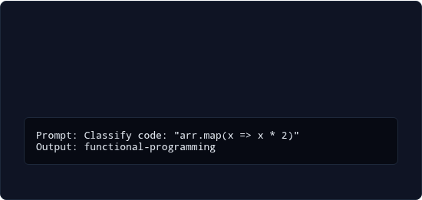
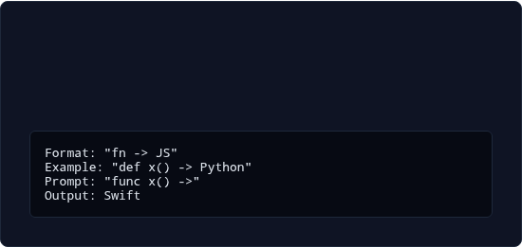
Zero-Shot vs. Few-Shot
Zero-Shot Operations
Few-Shot Scaffolding
Direct tasks without prior data scaffolding. Rely on natural base probability paths inside LLMs.
Introduce historical mock pairs. Forces strict replication of structures, semantics, or syntactic rules.
AI SEASON • SHOTS
AISEASON

Slide 8
Chain of Thought Prompting
Step-by-Step Chain
Synthesized Output
Explicit commands forcing systemic execution logs.
Accurate, validated and deterministic response models.
Problem State
Hidden Reasoning
Complex input data containing conflicting logic loops.
Self-verifying logic trace to correct intermediate errors.
AI SEASON •STEPS FOR PROMPTING
AISEASON

Slide 9





Role & System Prompting
Architect Persona
Security Guard
QA Debugger
Forces system to evaluate architectural trade-offs, tech debt constraints, structural integrity, and deployment paradigms.
Applies static code analysis paradigms, scans dependencies, structures protection patterns, and enforces secure code paths.
Simulates stress boundaries, generates extreme edge cases, structures unit assertions, and verifies asynchronous state behaviors.
AI SEASON • SYSTEMS PROMPTING
AISEASON

Slide 10
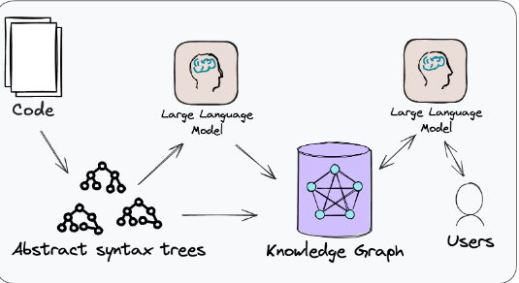
Context Engineering Rules
Context represents the operational boundary of an LLM. Providing raw instructions without local state yields poor, generalized outputs.
Input related code paths before prompting changes.
Supply complete schema designs for integration tasks.
Anchor development rules to precise user constraints.
AI SEASON • CONTEXT PRESERVED PROMPTS
AISEASON

Slide 11
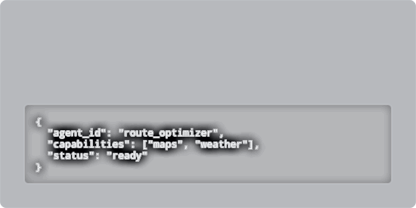


Securing Structured Outputs
Schema Enforced Targets
Mathematical Parsing
Eliminate conversational noise by forcing LLMs to return strict schemas. Ideal for building system interfaces.
Ensure reliable logic loops using MathML parsing parameters to govern computational steps.
AI SEASON • EFFECTIVE OUTPUTS
AISEASON

Slide 12
Prompt Chaining Workflows
Service Code
Unit Testing
Build backend service layer APIs aligning directly with the planned schema.
Run dynamic checks on integration workflows and mock state pipelines.
Schema Planning
UI Assembly
Generate database constraints and operational data structures first.
Develop front-end components mapped to active API definitions.
AI SEASON • STRATEGIC PROMPTING
AISEASON

Slide 13
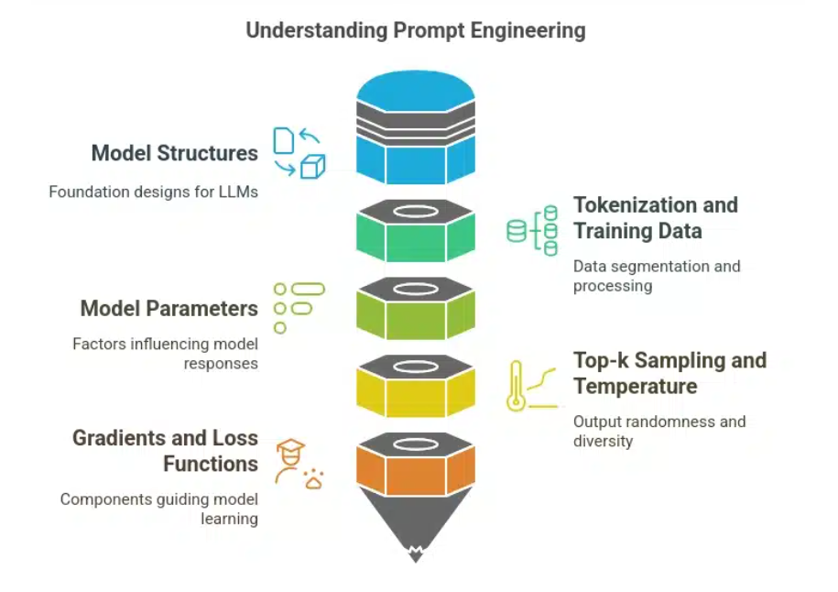
Expanding Agent Tools
Connecting LLMs to APIs
Raw foundational models are frozen snapshots of training datasets. Tool calling empowers them to execute active external mutations on real-world databases.
By declaring structured JSON API configurations, agents can dynamically search, calculate math, or mutate server state based on human instruction loops.
AI SEASON • AGENT CONNECTION
AISEASON

Slide 14
Common Mistakes to Avoid
Vague System Context: Relying on simple, high-level directives without specifying precise system requirements.
Missing Guardrails: Omitting negative constraints, leading to logical deviations and hallucinations.
Large Single-Step Prompts: Overloading a single prompt with multiple complex tasks rather than chaining them sequentially.
Zero Formatting Rules: Neglecting to dictate the exact structural outputs required by backend parsers.
AI SEASON • COMMON ISSUES
AISEASON

Slide 15

10x
Velocity Transformation
What is Vibe Coding?
The Paradigm Shift
A fast-paced, high-level approach to development where engineers move away from manually writing line-by-line syntax.
Instead, humans focus on defining logical frameworks, high-level design systems, and validation checks, leaving the actual code generation to autonomous AI agents.
AISEASON
AI SEASON • VIBE CODING

Slide 16
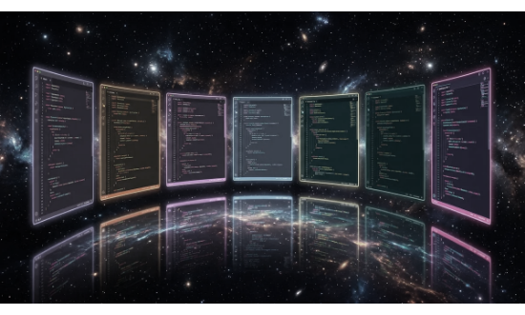
Modern Developer Workflows
The developer's primary job has changed. We are transitioning from raw coders to systems orchestrators and QA evaluators.
Agentic IDEs: Tools like Cursor and Windsurf autonomously plan, modify, and build complex projects.
Continuous Review: Developers guide the process by reviewing, testing, and debugging AI outputs.
AI SEASON • MODERN DEVELOPMENT
AISEASON

Slide 17

25-Minute Production Build
Identify the Target: Build a fully-featured travel planner app.
Apply Prompt Rules: Use a detailed system role, clean parameters, and structural rules.
Iterative Refinement: Build the UI first, connect the APIs, and debug any issues with the AI agent.
Deploy to Production: Ship the working app to a live staging server in under 25 minutes.
AI SEASON • BUILD PRODUCT
AISEASON

Slide 18
Innovation Begins with Curiosity
"AI will not replace humans. But humans using AI will replace humans not using AI."
Open Q&A Session
aiseason.tech
AI SEASON • CONCLUSION
AISEASON

